Slide 1
OOP PART 2

Slide 2
agenda
Encapsulation
inheritance
Class object
IS-a and has-a relationships
Polymorphism
Overriding and overloading
Constructors
Assignments and casting

Slide 3
Encapsulation
What is it?
HOW is it done?
Binding the data with the code that manipulates it
Keeping the data and the code safe from external interference
Wrapping up data members (state) and methods (behavior) together into a single unit (i.e. Class)
private instance variables
public Getters and setters to access hidden variables

Slide 4
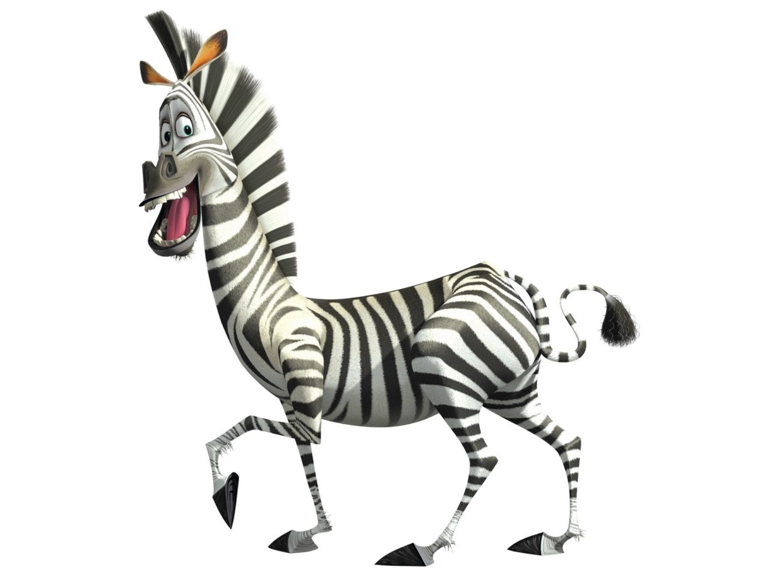
Encapsulation
State: weight, color, nickname, number of stripes
Behaviour: eat, trot, sleep
Class = blueprint
Object = instance of a class
State = instance variables
Behaviour = methods

Slide 5
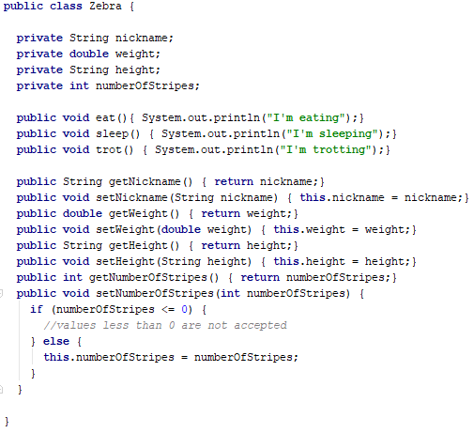
Encapsulation

Slide 6
agenda
Encapsulation
inheritance
Class object
IS-a and has-a relationships
Polymorphism
Overriding and overloading
Constructors
Assignments and casting

Slide 7
INHERITANCE

